Slide 1

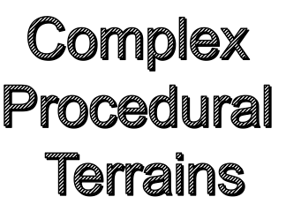
Zhimin Zhao
11/30/2015

Slide 2

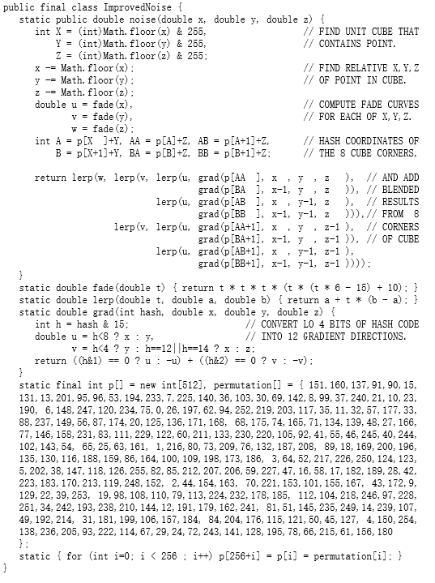
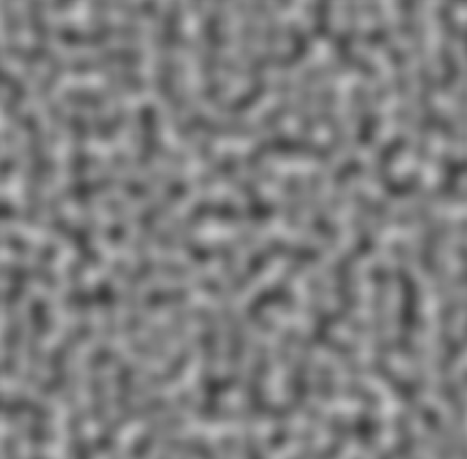
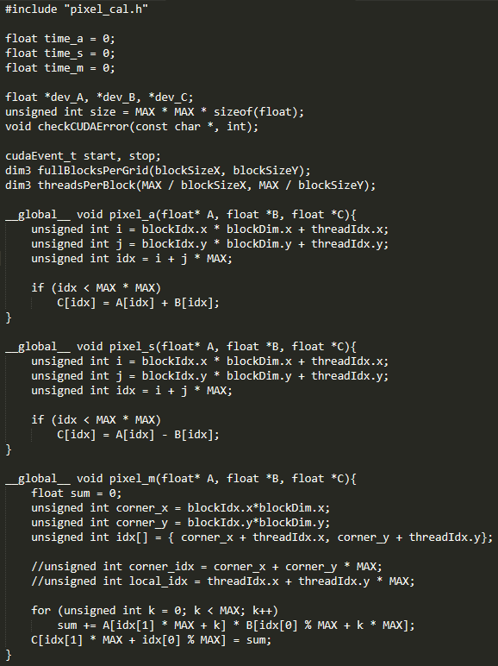

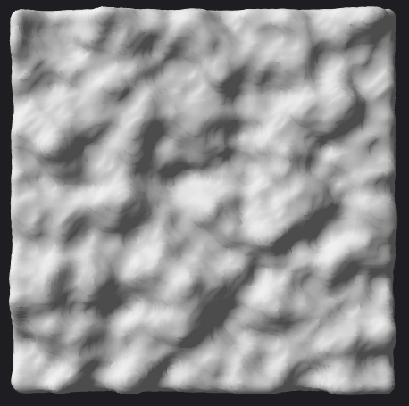
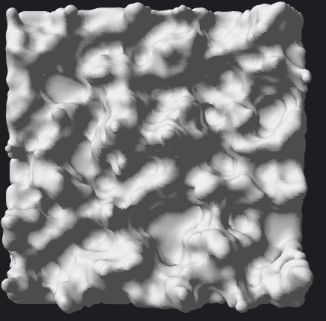
Milestone 2
Terrain Generation
Feature:
1. 2D Perlin noise function (2002 SigGraph)
Better than combination of trigonometric function
2. Pixel processing in paralllel (CUDA)
3. Iterative noise overlay for each pixel (5th order)
four parameters: (1) octave (2) amplitude (3) frequency (4) seed
0th order
2th order
5th order
3

Slide 3
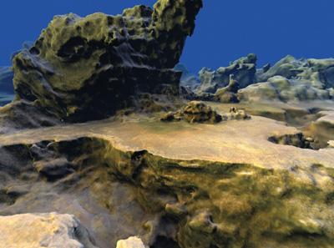
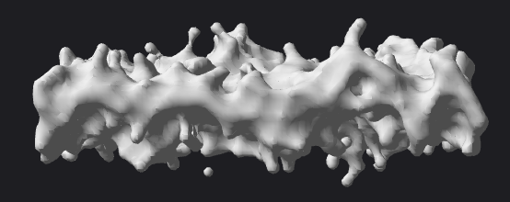
Problem
NO ideas how to make noise to generate an "outstanding" rock, e.g. Dent & Extrusion
Failed example:
3

Slide 4
Next Step
1. Terrain roaming (interactivity)
2. Terrain texture mapping (color)
3. Integrate various noise to make more interesting terrain features (such as caves, ridge, fault, overhangs)
4. Stream compaction for the blind terrain
5. Marching cube paralleling
3

Slide 5



